Slide 1
MHW1
Manusia Michele
O46001264
02/04/2022

Slide 2
Descrizione del progetto
Il progetto in questione prevede un e-commerce indirizzato nella vendita di orologi. La pagina iniziale prevede:
Un header con relativa navbar e link (momentaneamente non funzionanti) alle varie sezioni del sito.
La section con un primo box descrittivo e un secondo box diviso in 4 parti relative alle principali categorie di prodotti. Ogni box del secondo gruppo ha un link verso la categoria di prodotto.
Footer informativo.

Slide 3
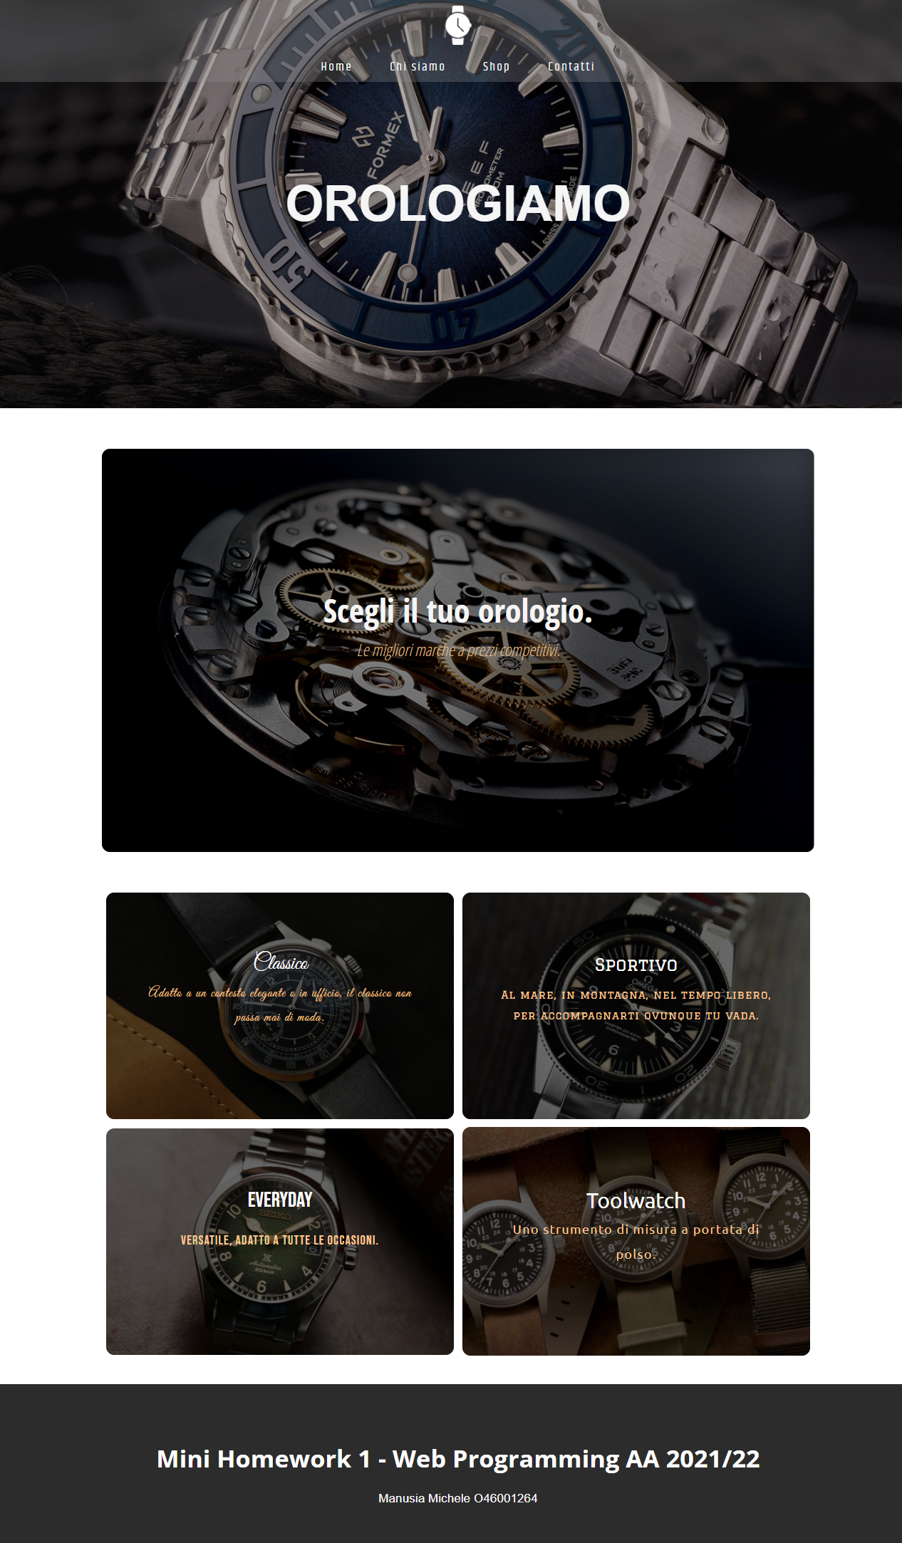
Layout complessivo HTML+CSS

Slide 4
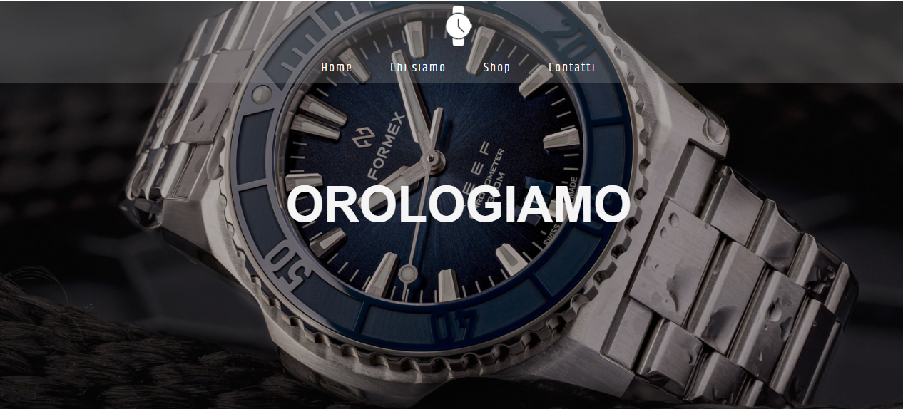
Header (HTML)
500px
3em
<header>
<nav>
</nav>
<div id ="overlay"></div>
<h1>
OrologiAmo
</h1>
</header>
N.B. La nav è inserita nell’header, il codice è descritto nell’apposita slide.

Slide 5
Header (CSS)
header {
color: white;
height: 500px;
width: 100%;
background-image: url(https://www.ablogtowatch.com/wp-content/uploads/2020/09/Formex-Reef-Automatic-Chronometer-watch-12.jpg);
background-size: cover;
background-position: center;
position: relative;
display: flex;
flex-direction: column;
align-items: center;
justify-content: center;
}
#overlay {
background-color:
rgba(0, 0, 0, 0.3);
position: absolute;
top: 0;
bottom: 0;
height: 100%;
width: 100%;
}
header h1 {
color: whitesmoke;
text-align: center;
z-index: 1;
text-transform: uppercase;
font-size: 3em;
}

Slide 6

Menù navigazione (HTML)
100px
<nav>
<div id="logo">
<img src=watch-icon-clipart-6.png />
</div>
<div id="links">
<a class="button">Home</a>
<a class="button">Chi siamo</a>
<a class="button">Shop</a>
<a class="button">Contatti</a>
</div>
</nav>

Slide 7
Menù navigazione (CSS)
a {
cursor: pointer;
}
#logo{
display: flex;
align-items: center;
}
#logo img {
width: 48px;
height: 48px;
}
a.button {
font-family: 'Khand', sans-serif;
font-size: .75em;
letter-spacing: 2px;
color: white;
padding: 5px 20px;
border-radius: 2px;
}
a.button:hover {
background-color: #ffffff;
color: black;
}
a.button:active {
background-color: rgba(0, 0, 0, 0.4);
color: rgb(255, 255, 255);
}
header nav{
background-color:rgba(144, 144, 144, 0.3);
height: 100px;
width: 100%;
margin-top: 0px;
display:flex;
position: absolute;
top: 0;
right: 0;
left: 0;
flex-direction: column;
align-items: center;
justify-content: space-around;
z-index: 1;
}

Slide 8
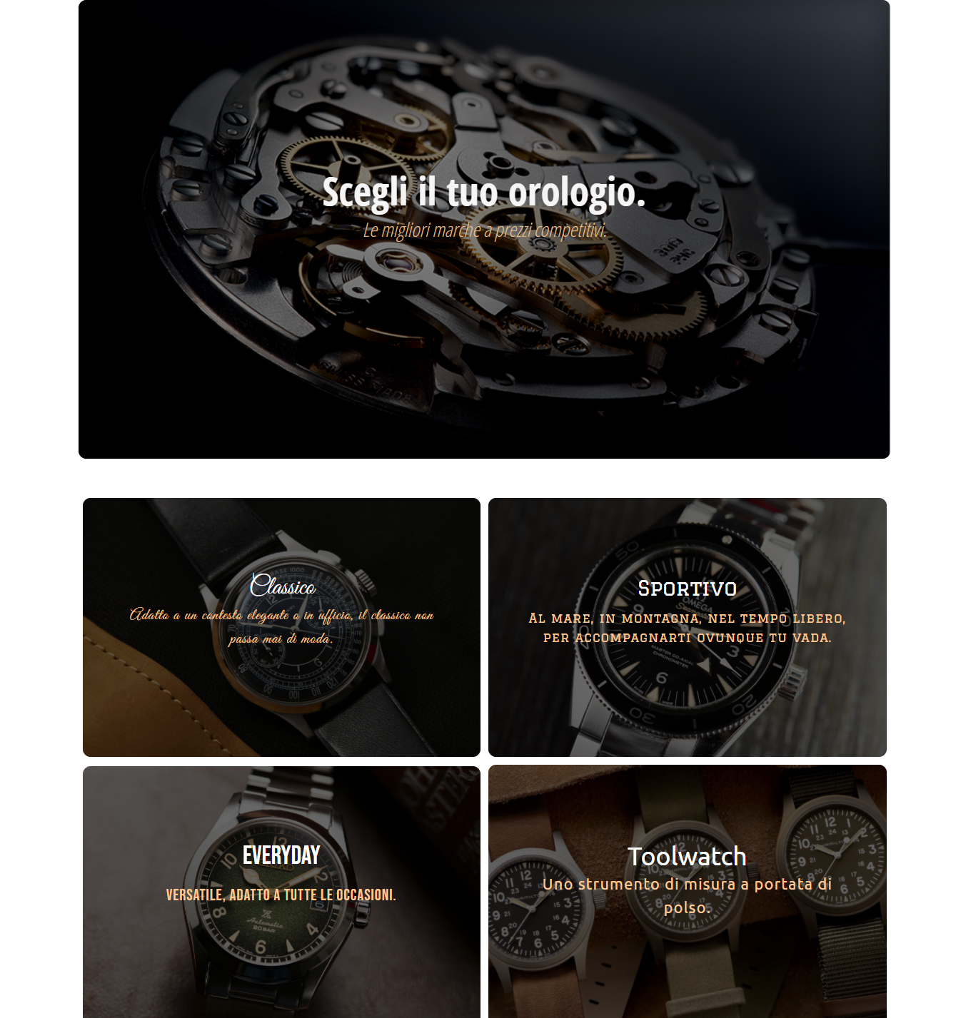
Sezione contenuti
50px
50px
50px
100px
100px
50px

Slide 9
Sezione contenuti (HTML)
<section>
<div class="container">
<div id ="overlay"></div>
<img src="https://motionintime.com/wp-content/uploads/2020/01/top-mouvements.jpg" />
<strong>Scegli il tuo orologio.</strong>
<em>Le migliori marche a prezzi competitivi. </em>
</div>
<div class="categories">
<div id="elegant">
<img src="https://timeandtidewatches.com/wp-content/uploads/2020/07/Dan-Henry-Black2-845x550@2x.jpg" />
<a class="button2">Classico</a>
<p>Adatto a un contesto elegante o in ufficio, il classico non passa mai di moda.</p>
<div id ="overlay"></div>
</div>
<div id="sport">
<img src="https://timeandtidewatches.com/wp-content/uploads/2018/11/Omega-Seamaster-300-month-7.jpg" />
<a class="button2">Sportivo</a>
<p>Al mare, in montagna, nel tempo libero, per accompagnarti ovunque tu vada.</p>
<div id ="overlay"></div>
</div>
</div>
<div class="categories">
<div id="everyday">
<img src="https://timeandtidewatches.com/wp-content/uploads/2020/09/Seiko-SPB155J1-2338-845x550@2x.jpg" />
<a class="button2">Everyday</a>
<p>Versatile, adatto a tutte le occasioni.</p>
<div id ="overlay"></div>
</div>
<div id="tool">
<img src=Hamilton-Khaki-Field-Mechanical-2019-4-1.jpg />
<a class="button2">Toolwatch</a>
<p>Uno strumento di misura a portata di polso.</p>
<div id ="overlay"></div>
</div>
</div>
</section>

Slide 10
Sezione contenuti (CSS)
section{
margin: 100px 100px;
text-align: center;
position: relative;
}
.container{
margin-top: 50px;
margin-left: 100px;
margin-right: 100px;
margin-bottom: 50px;
position: relative;
display: flex;
flex-direction: column;
align-items: center;
justify-content: center;
}
.container img{
position: relative;
width: 100%;
height: 100%;
border-radius: 10px;
z-index: -1;
}
.container strong{
font-family: 'Open Sans Condensed', sans-serif;
position: absolute;
color: whitesmoke;
text-align: center;
margin-bottom: 100px;
font-size: 2em;
}
.container em{
font-family: 'Open Sans Condensed', sans-serif;
position: absolute;
color: burlywood;
text-align: center;
font-size: 1em;
}
.container #overlay {
background-color:rgba(0, 0, 0, 0.5);
position: absolute;
top: 0;
bottom: 0;
height: 100%;
width: 100%;
border-radius: 10px;
z-index: 0;
}
.categories{
background-color: rgb(255, 255, 255);
margin-left: 100px;
margin-right: 100px;
display: flex;
align-items: center;
justify-content: space-around;
}
.categories img{
position: relative;
width: 100%;
height: 100%;
border-radius: 10px;
}
.categories div{
margin-left: 5px;
margin-right: 5px;
margin-bottom: 10px;
width: 50wh;
height: 50wh;
display: flex;
position: relative;
align-items: center;
justify-content: space-around;
flex-grow: 1;
}

Slide 11
Sezione contenuti (CSS)
.categories a{
position: absolute;
color: whitesmoke;
text-align: center;
margin-bottom: 100px;
font-size: 1.3em;
z-index: 1;
}
.categories p{
position: absolute;
color: rgb(255, 199, 147);
text-align: center;
letter-spacing: 1px;
font-size: .8em;
z-index: 1;
margin: 10%;
}
a.button2 {
color: white;
padding: 5px 10px;
border-radius: 10px;
}
a.button2:hover {
background-color: #ffffff;
color: black;
}
a.button2:active {
background-color: rgba(0, 0, 0, 0.4);
color: rgb(255, 255, 255);
}
.categories #overlay {
background-color:rgba(0, 0, 0, 0.6);
position: absolute;
top: 0;
bottom: 0;
height: 100%;
width: 100%;
border-radius: 10px;
z-index: 0;
}
#elegant{
font-family: 'Great Vibes', cursive;
font-style: normal;
font-weight: 400;
font-size: 1em;
line-height: 30px;
}
#sport{
font-family: 'Graduate', cursive;
font-style: normal;
font-weight: 300;
font-size: .8em;
line-height: 25px;
}
#everyday{
font-family: 'Bebas Neue', cursive;
font-style: normal;
font-weight: 300;
font-size: 1em;
line-height: 30px;
}
#tool{
font-family: 'Ubuntu', sans-serif;
font-style: normal;
font-weight: 400;
font-size: 1em;
line-height: 30px;
}

Slide 12
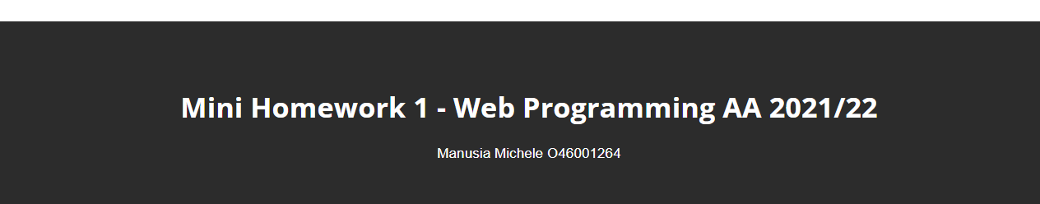
Footer
<footer>
<h1>Mini Homework 1 - Web Programming AA 2021/22</h1>
<p>Manusia Michele O46001264</p>
</footer>
footer {
color:white;
background-color: rgb(44, 44, 44);
padding: 50px;
text-align: center;
}
footer h1{
font-family: 'Open Sans', sans-serif;
font-size: 1.5em;
}
footer p{
font-size: .75em;
}

